Slide 1
Branch and Bound
CSE 2202: Algorithm Analysis and Design Laboratory
Most. Kaniz Fatema Isha
Md Mehrab Hossain Opi

Slide 2
0/1 Knapsack Problem
You are given a set of n items, each with a weight w[i] and a profit v[i].
You have a knapsack that can hold a maximum weight W.
Your task is to determine the maximum profit you can obtain by selecting a subset of the items such that their total weight does not exceed W.
Each item can either be taken (1) or not taken (0), hence the "0/1" in the problem name.
You cannot take fractional parts of an item.

Slide 3
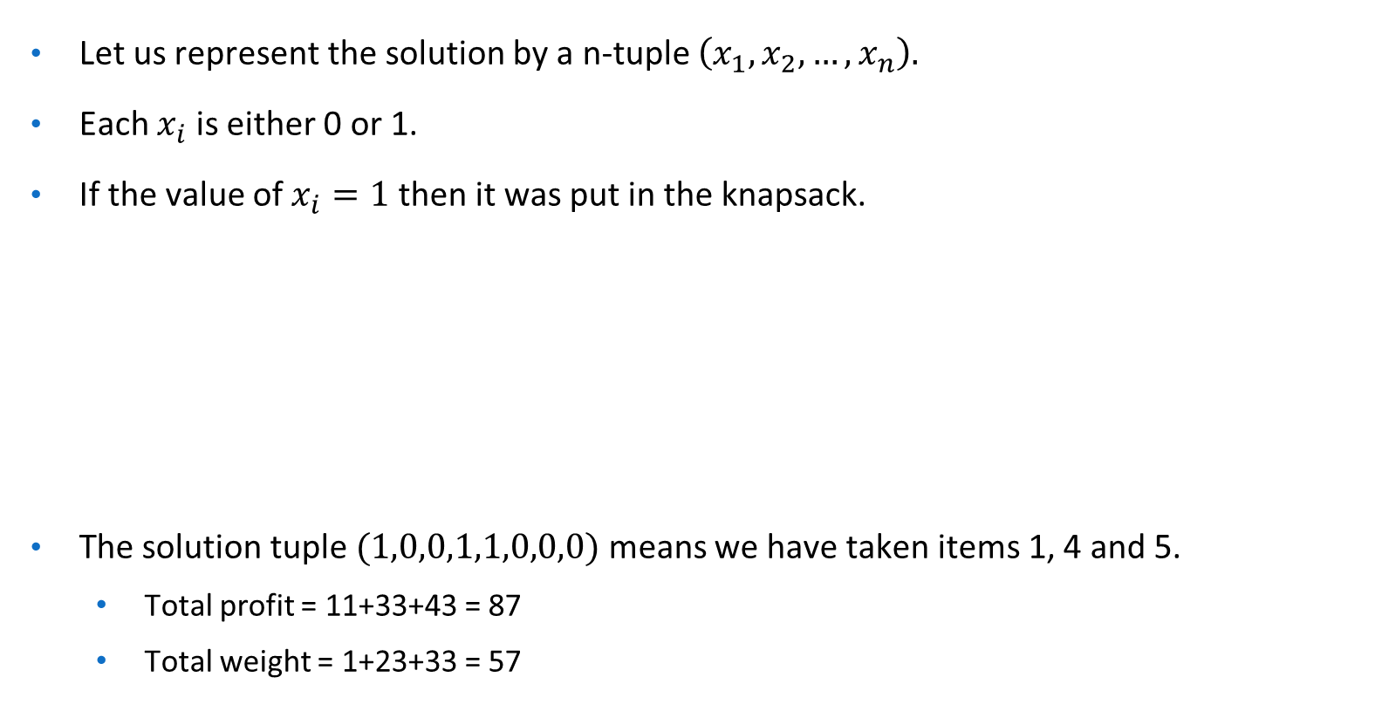
Solution Representation
Let, n = 8
p[] = {11, 21, 31, 33, 43, 53, 55, 65}
w[] = {1,11,21,23,33,43,45,55}
W = 110

Slide 4
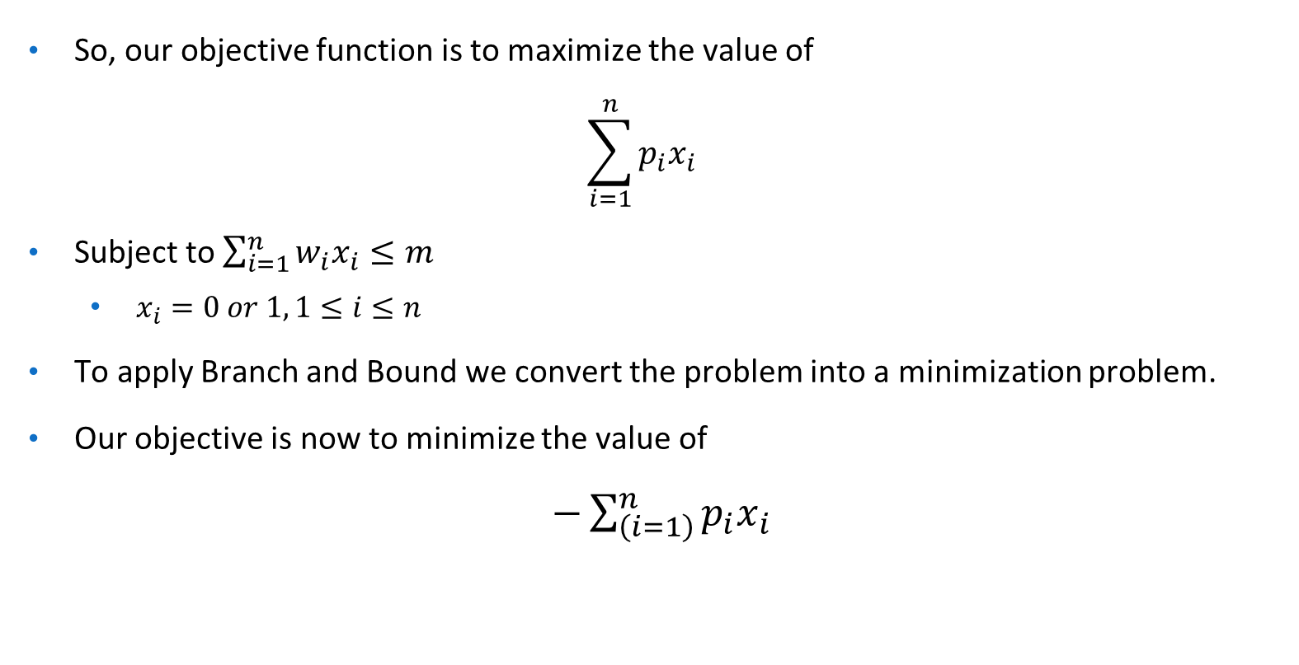
0/1 Knapsack Problem

Slide 5
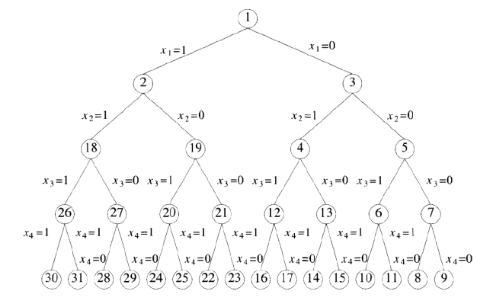
State Space Tree
The solution space can be represented by a binary tree.

Slide 6
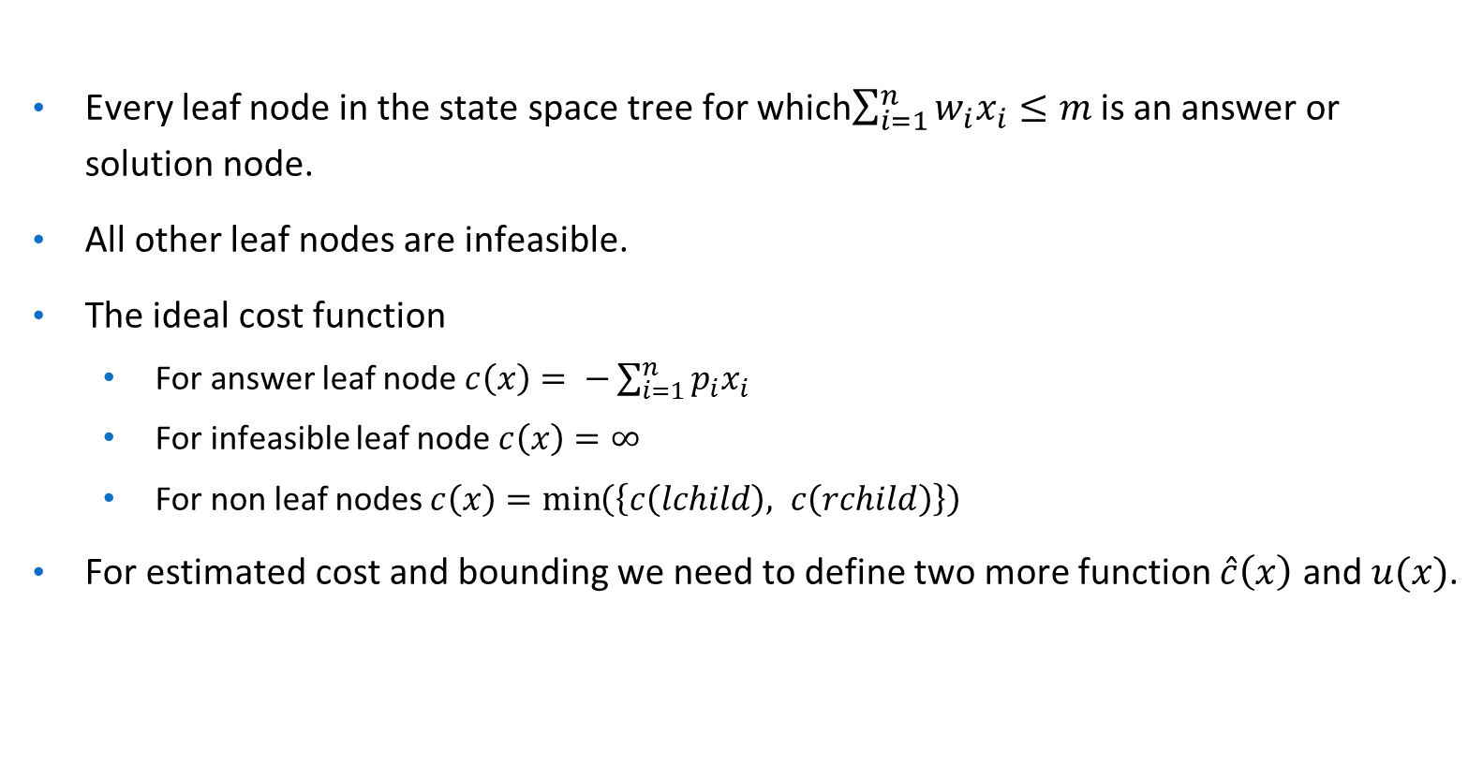
State Space Tree

Slide 7
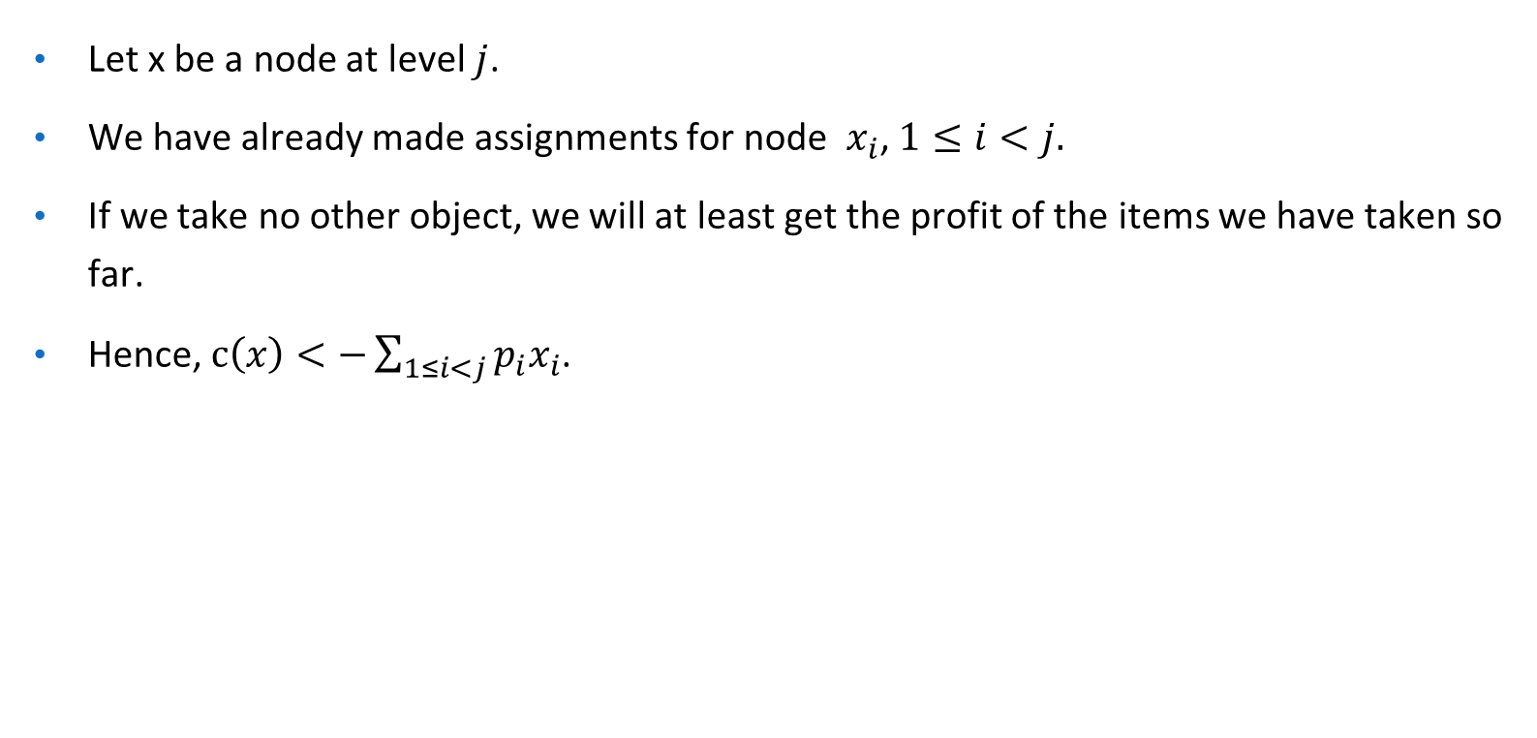
Lower Bound and Upper Bound Calculation

Slide 8
Lower Bound and Upper Bound Calculation
Lower Bound can be calculated using the following function
Algorithm Bound(cp, cw, k, m)
// cp = current profit, cw = current weight total,
// k = index of the last removed item; m = knapsack size
// w[i] and p[i] are respectively the weight and profit of the ith object
{
b:=cp; c:=cw;
for i:= k+1 to n do{
c:= c+w[i];
if(c<m) then b:=b+p[i];
else return b+(1-(c/m)/w[i])*p[i];
}
return b;
}

Slide 9
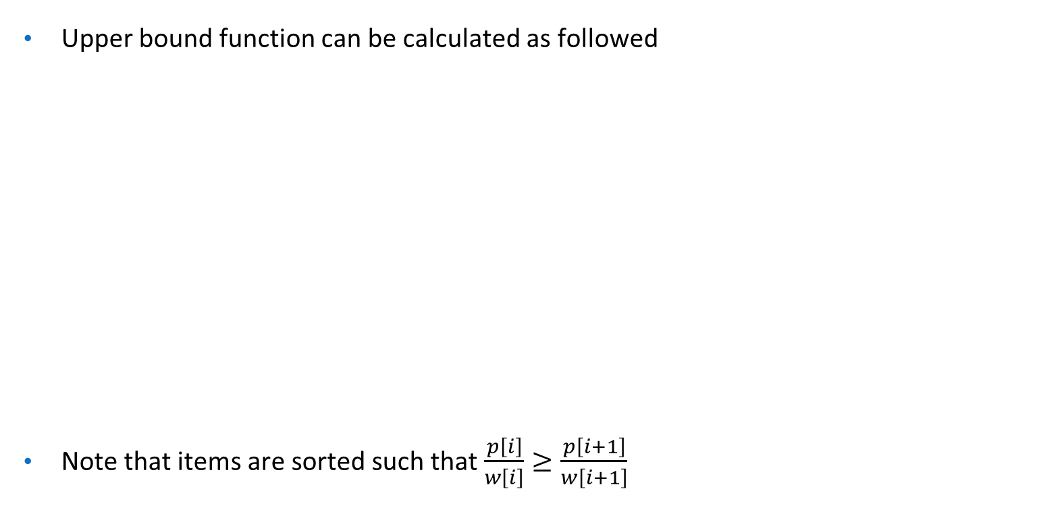
Lower Bound and Upper Bound Calculation
Algorithm Ubound(cp, cw, k, m)
// cp = current profit, cw = current weight total,
// k = index of the last removed item; m = knapsack size
// w[i] and p[i] are respectively the weight and profit of the ith object
{
b:=cp; c:=cw;
for i:= k+1 to n do{
if(c+w[i]<=m) then
{
c:=c+w[i]; b:=b-p[i];
}
}
return b;
}

Slide 10
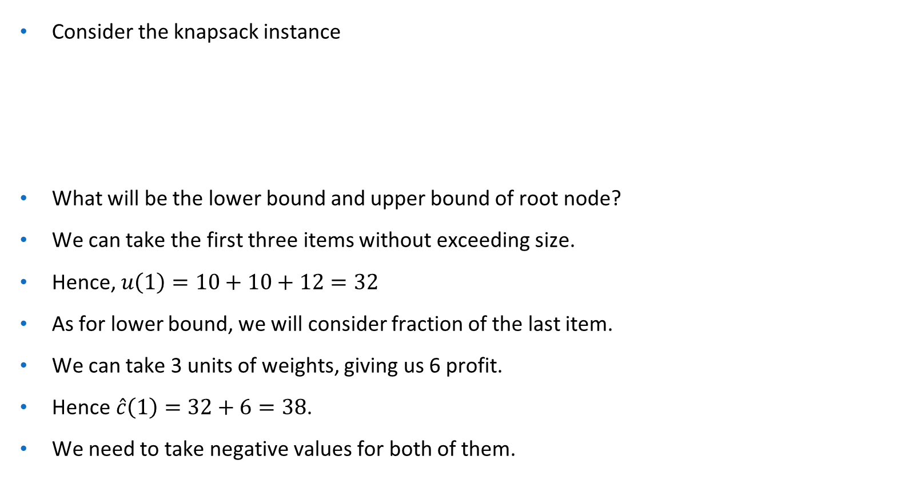
LC Branch-and Bound Solution
n = 4
p[] = {10, 10, 12, 18}
w[] = {2, 4, 6, 9}
W = 15

Slide 11
LC Branch-and Bound Solution
n = 4
p[] = {10, 10, 12, 18}
w[] = {2, 4, 6, 9}
W = 15
-38
-32
1
1
0
-38
-32
2
3
-22
-32
1
0
-38
-32
4
5
-36
-22
1
0
-38
-32
6
7
-38
-38
1
0
-38
-38
8
9
-20
-20

Slide 12
References
Computer Algorithms
– Ellis Horowitz, Sartaj Sahni, Sanguthevar Rajasekaran.

